Slide 1
Machine learning, basic principles and example applications
Trial lecture
Adriaen Verheyleweghen
Supervisor: Johannes Jäschke
Co-supervisor: Sigurd Skogestad
June 12, 2020

Slide 2
Outline
Machine learning – what is it?
Unsupervised learning
  K-means clustering
  Hierarchical clustering
  Generative algorithms
Supervised learning
  Linear regression
  Gradient descent
  Classification / logistic regression
Reinforcement learning
Conclusion

Slide 3
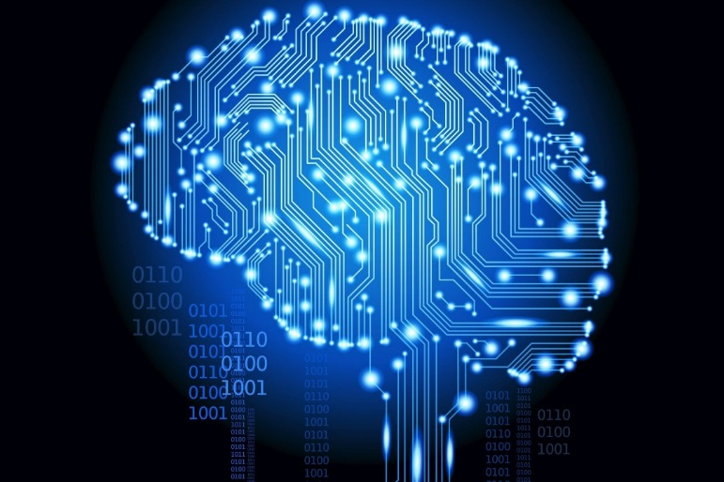
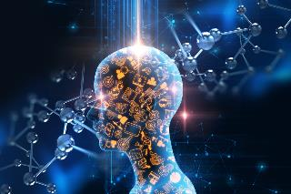
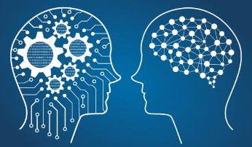
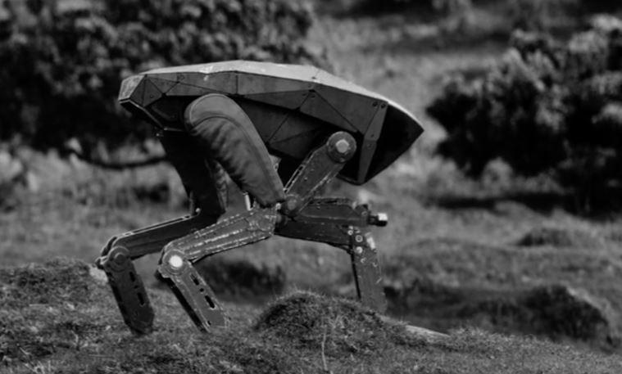
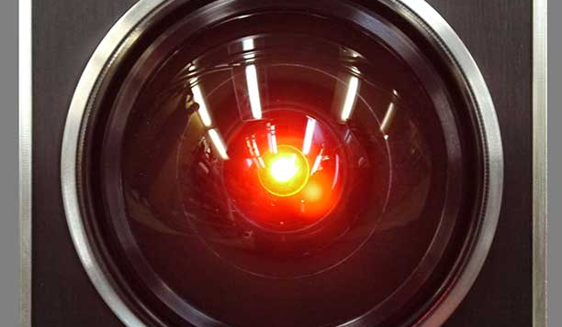
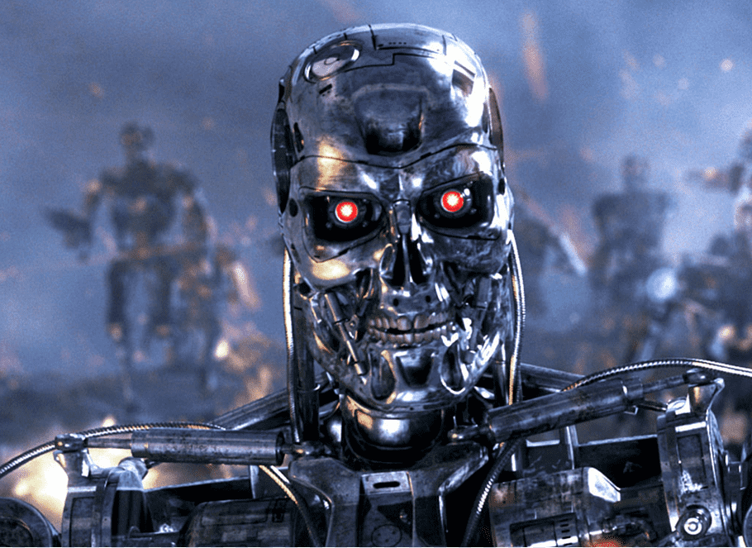
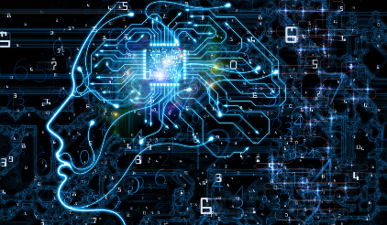
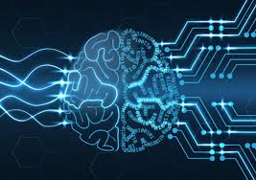
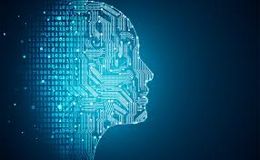

Machine learning – what is it?
A lot of hype (and blue brains), but is it useful?

Slide 4


Machine learning – what is it?
Subset of artificial intelligence and computer science, where statistics is used to teach a computer to do a task without being explicitly programmed

Slide 5
Machine learning – what is it?
Turn right
Go 4 steps forward
Turn left
Go 6 steps forward
…

Slide 6
Machine learning – what is it?
Turn right
Go 4 steps forward
Turn left
Go 6 steps forward
…

Slide 7
Machine learning – what is it?
Turn right
Go 4 steps forward
Turn left
Go 6 steps forward
…

Slide 8
Machine learning – what is it?
Turn right
Go 4 steps forward
Turn left
Go 6 steps forward
…

Slide 9
Machine learning – what is it?
Turn right
Go 4 steps forward
Turn left
Go 6 steps forward
…

Slide 10
Machine learning – what is it?
1. Locate goal
2. Find direction that minimizes
distance to goal
3. Take a step in that direction
4. Repeat

Slide 11




Machine learning – what is it?
A way for machines to “learn”, using data instead of experience

Slide 12
Machine learning
Machine learning
Supervised learning
Unsupervised learning
Reinforcement learning
Classification:
Predict a category
Regression:
Predict a number
Clustering:
Divide by similarity
Association:
Identify sequences
Dimension reduction:
Find hidden dependencies
Decision making:
Automatic decision making
… and many, many more!

Slide 13
Machine learning
Machine learning
Supervised learning
Classification:
Predict a category
Regression:
Predict a number
Unsupervised learning
Clustering:
Divide by similarity
Reinforcement learning
Association:
Identify sequences
Dimension reduction:
Find hidden dependencies
Decision making:
Automatic decision making
… and many, many more!

Slide 14
Machine learning
Machine learning
Supervised learning
Classification:
Predict a category
Regression:
Predict a number
Unsupervised learning
Clustering:
Divide by similarity
Reinforcement learning
Association:
Identify sequences
Dimension reduction:
Find hidden dependencies
Decision making:
Automatic decision making
… and many, many more!

Slide 15
Unsupervised learning - clustering
How can we divide individuals into subsets or clusters? Such that individuals from the same group are “similar”, and individuals from different groups are “dissimilar” ?

Slide 16
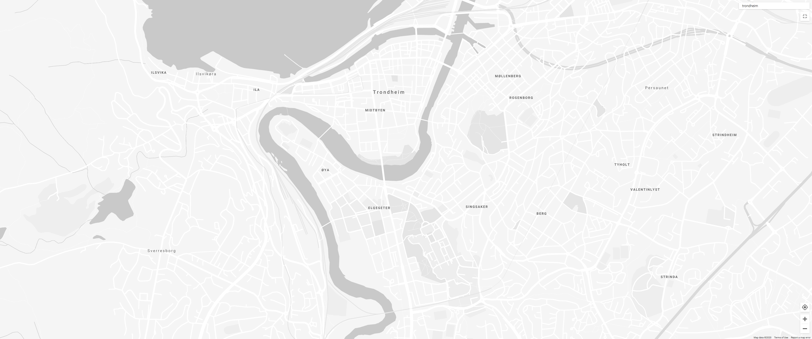

Where to place bike stations?

Slide 18
1) Initialize randomly

Slide 19
2) Assign points to nearest center

Slide 20
3) Move center to mean location

Slide 25
K-means clustering

Slide 27
Why exactly 3 clusters?

Slide 28
Why exactly 3 clusters?
11
9
10
8
1
7
2
3
5
4
6

Slide 29
11
9
10
8
1
7
Distance (km)
2
3
5
4
6

Slide 30
11
9
10
8
1
7
Distance (km)
2
3
5
4
6
Dendrogram

Slide 31
11
9
10
8
1
7
Distance (km)
2
3
5
4
6
Dendrogram

Slide 32
11
9
10
8
1
7
Distance (km)
2
3
5
4
6
Dendrogram

Slide 33
11
9
10
8
1
7
Distance (km)
2
3
5
4
6
Dendrogram

Slide 34
11
9
10
8
1
7
Distance (km)
2
3
5
4
6
Dendrogram

Slide 35
11
9
10
8
1
7
Distance (km)
2
3
5
4
6
Dendrogram

Slide 36
11
9
10
8
1
7
Distance (km)
2
3
5
4
6
Dendrogram

Slide 37
11
9
10
8
1
7
Distance (km)
2
3
5
4
6
Dendrogram

Slide 38
11
9
10
8
1
7
Distance (km)
2
3
5
4
6
Dendrogram

Slide 39
11
9
10
8
1
7
Distance (km)
2
3
5
4
6
Dendrogram

Slide 40
11
9
10
8
1
7
Distance (km)
2
3
5
4
6
Dendrogram

Slide 41
11
9
10
8
1
7
Distance (km)
2
3
5
4
6
Dendrogram

Slide 42
11
9
10
8
1
7
Distance (km)
2
3
5
4
6
Dendrogram

Slide 43
11
9
10
8
1
7
Distance (km)
2
3
5
4
6
Dendrogram

Slide 44
11
9
10
8
1
7
Distance (km)
2
3
5
4
6
Dendrogram

Slide 45
11
9
10
8
1
7
Distance (km)
2
3
5
4
6
Dendrogram

Slide 46
11
9
10
8
1
7
Distance (km)
2
3
5
4
6
Dendrogram

Slide 47

11
9
10
8
1
7
Distance (km)
2
3
Distance too large!
5
4
6
Dendrogram

Slide 48
11
9
10
8
1
7
Distance (km)
2
3
5
4
6
Hierarchical clustering
Dendrogram

Slide 49




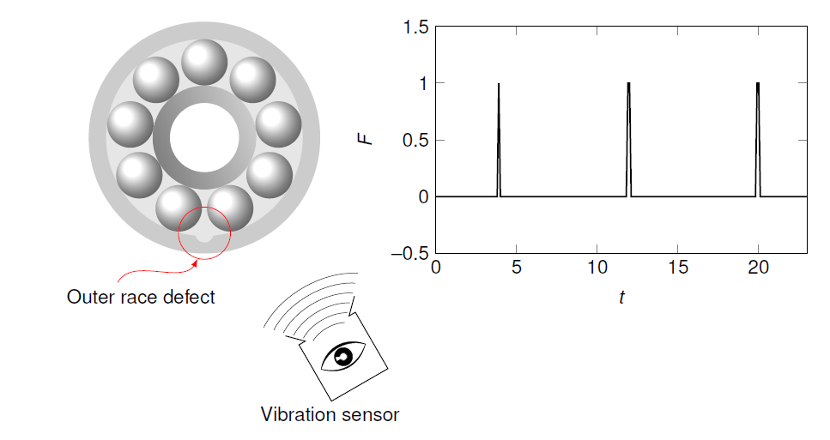
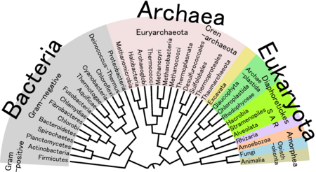
Clustering – areas of application
Recommendation systems
Targeted marketing
Biology
Anomaly detection

Slide 50
Machine learning
Machine learning
Supervised learning
Classification:
Predict a category
Regression:
Predict a number
Unsupervised learning
Clustering:
Divide by similarity
Reinforcement learning
Association:
Identify sequences
Dimension reduction:
Find hidden dependencies
Decision making:
Automatic decision making

Slide 51
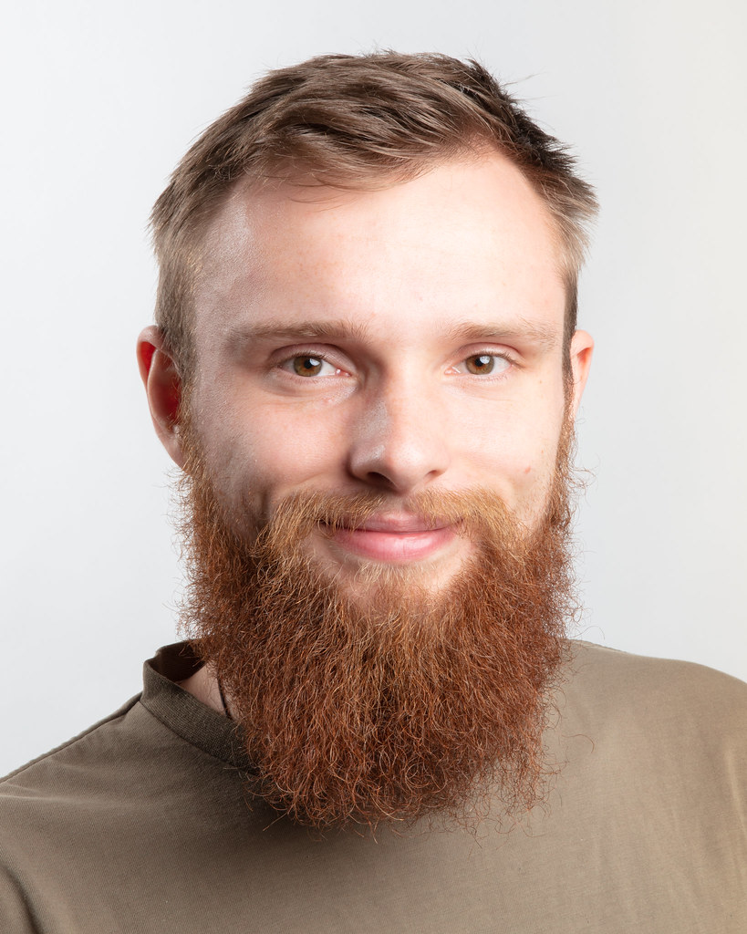
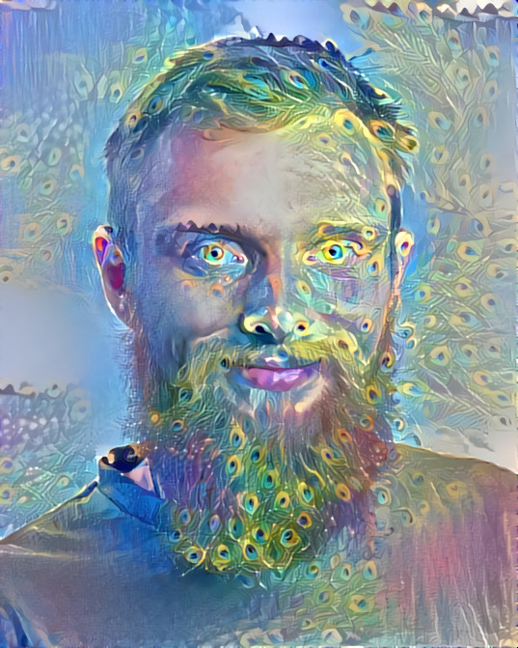
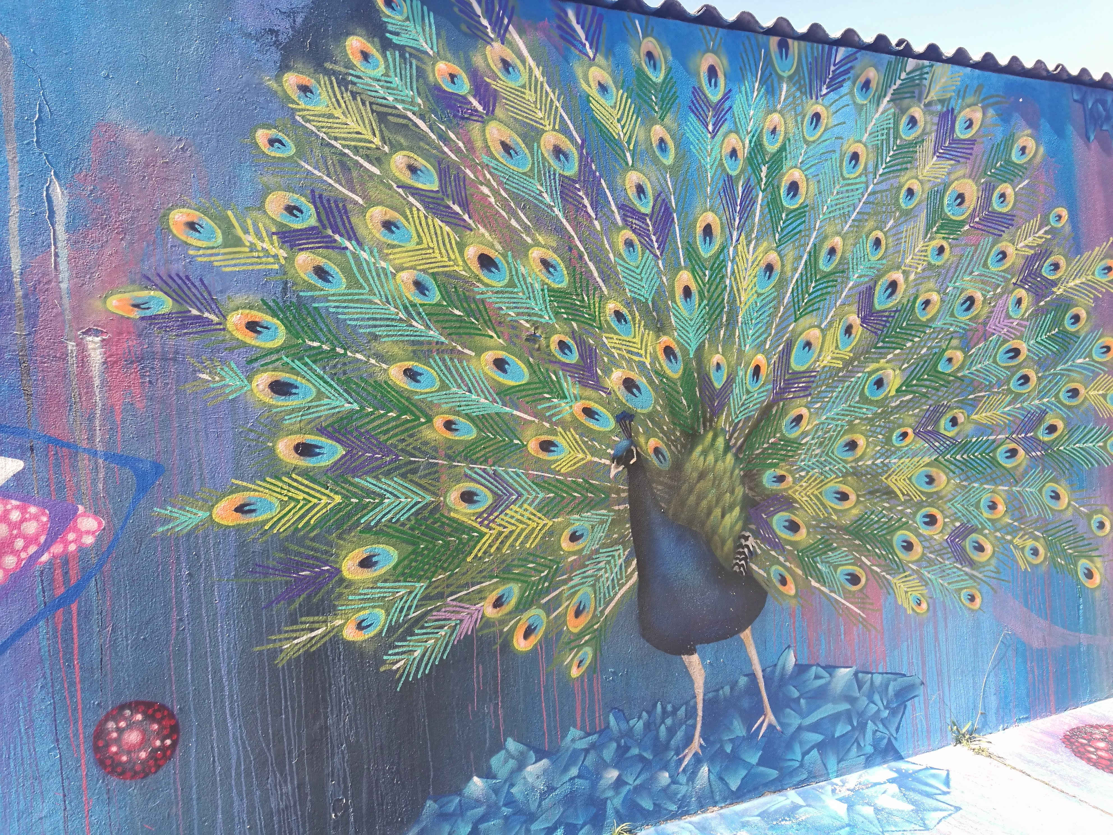
Unsupervised learning – generative algorithms
“What I cannot create, I do not understand.”
— Richard Feynman

Slide 52
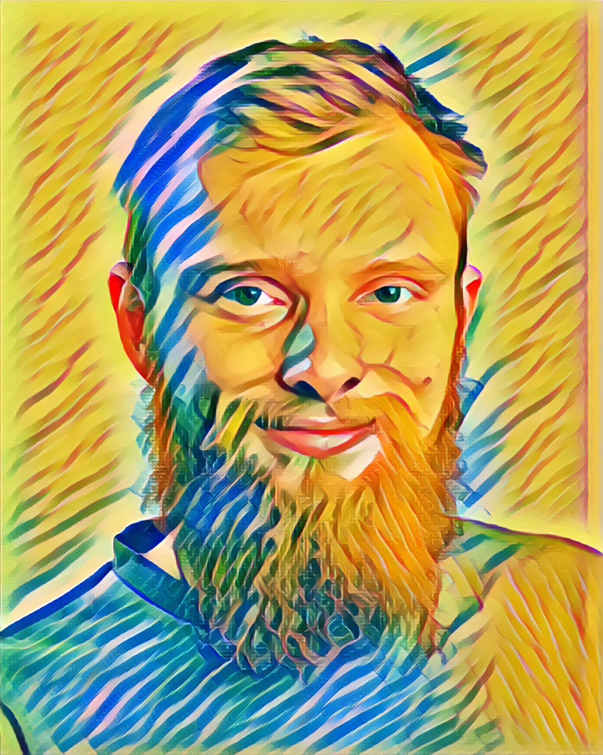
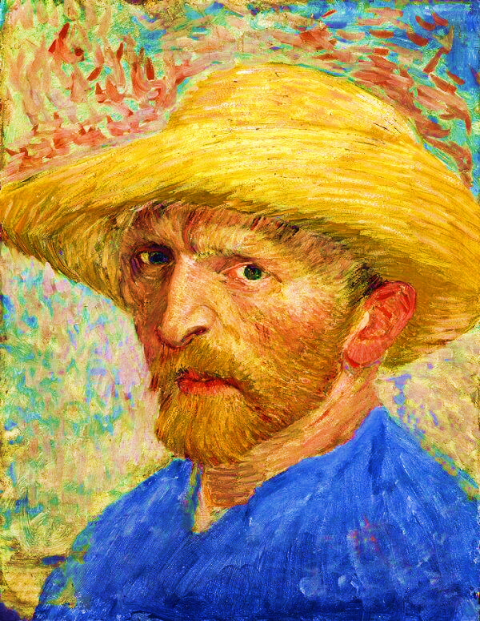
Unsupervised learning – generative algorithms

Slide 53
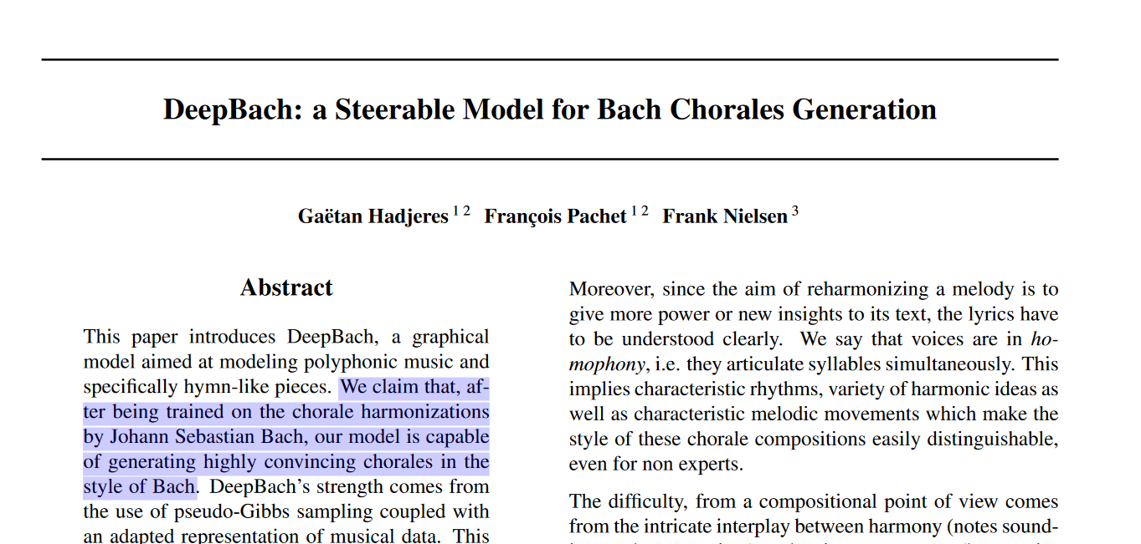
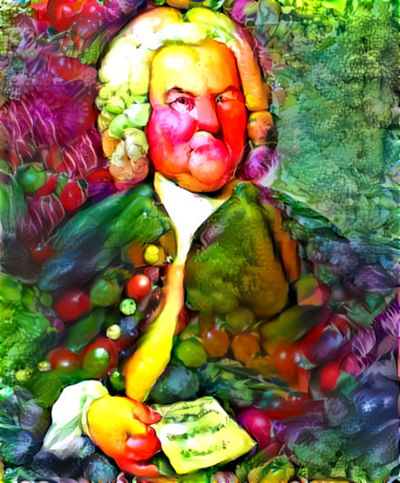

Slide 54
Unsupervised learning – generative algorithms
How is this useful?
Visualizing how the ML algorithm “thinks”

Slide 55
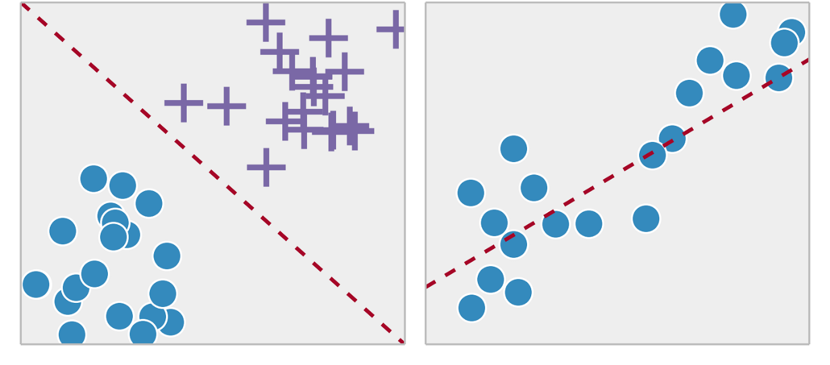
Machine learning
Machine learning
Supervised learning
Classification:
Predict a category
Regression:
Predict a number
Unsupervised learning
Clustering:
Divide by similarity
Reinforcement learning
Association:
Identify sequences
Dimension reduction:
Find hidden dependencies
Decision making:
Automatic decision making

Slide 56
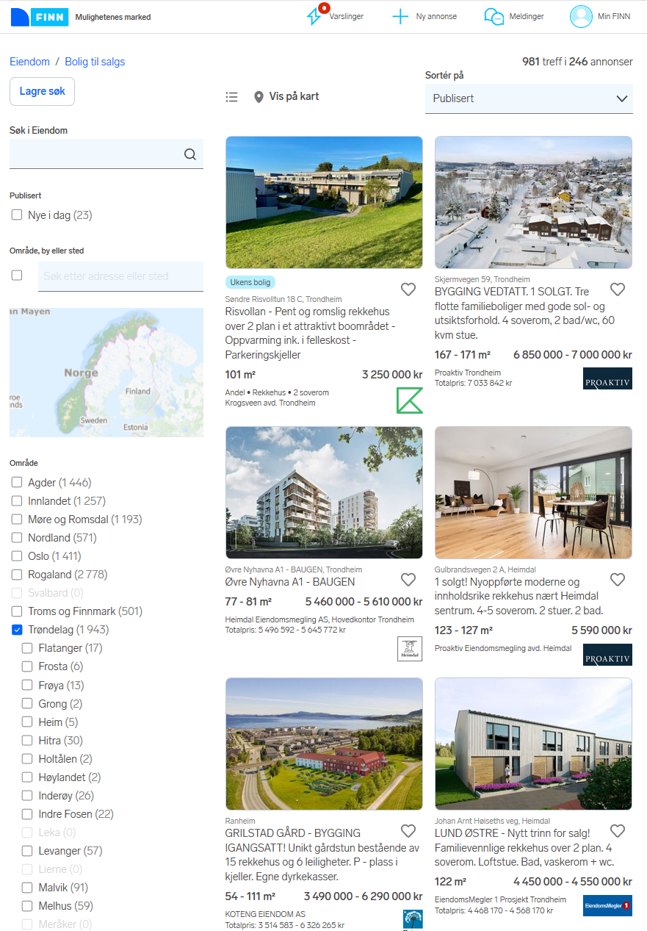
Supervised learning – (linear) regression

Slide 57
Supervised learning – (linear) regression

Slide 58
Supervised learning – (linear) regression
Come closer

Slide 59
Supervised learning – (linear) regression
Come closer

Slide 60
Supervised learning – (linear) regression
Come closer

Slide 61
Supervised learning – (linear) regression

Slide 62



Supervised learning – (linear) regression
$$\left(y_{pred,i}−y_{i}\right)$$
$$\left(y_{pred,i}−y_{i}\right)$$
$$y_{pred}=a_{0}+a_{1}x$$

Slide 63


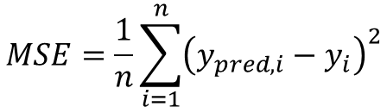

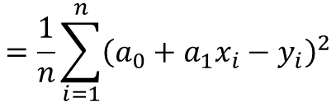
Supervised learning – (linear) regression
$minimize MSE$(mean square error)
$$MSE=\frac{1}{n}\sum_{i=1}^{n}{{\left(y_{pred,i}−y_{i}\right)}^{2}}$$
$$=\frac{1}{n}\sum_{i=1}^{n}{{\left(a_{0}+a_{1}x_{i}−y_{i}\right)}^{2}}$$
$$2$$
$$2$$
$$\left(y_{pred,i}−y_{i}\right)$$
$$\left(y_{pred,i}−y_{i}\right)$$
$$y_{pred}=a_{0}+a_{1}x$$

Slide 64
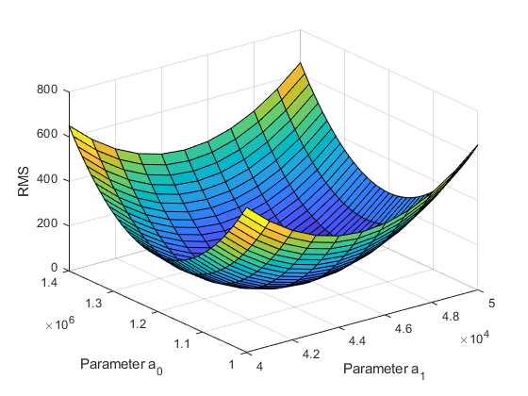
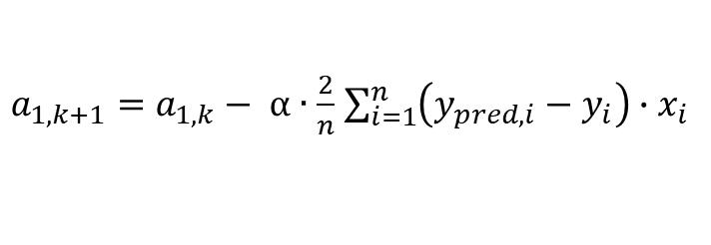
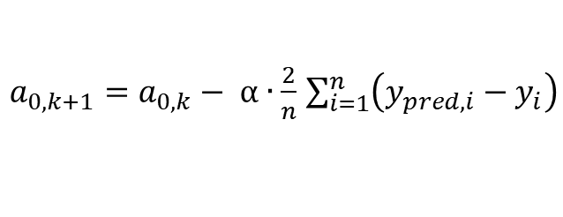
Supervised learning – (linear) regression
How to minimize MSE?
  Gradient descent!
$minimize MSE$(mean square error)
$$MSE=\frac{1}{n}\sum_{i=1}^{n}{{\left(y_{pred,i}−y_{i}\right)}^{2}}$$
$$=\frac{1}{n}\sum_{i=1}^{n}{{\left(a_{0}+a_{1}x_{i}−y_{i}\right)}^{2}}$$
MSE
Which direction to step?
$a_{0,k+1}=a_{0,k}− α∙\frac{2}{n}$ $\sum_{i=1}^{n}{\left(y_{pred,i}−y_{i}\right)}$
$a_{1,k+1}=a_{1,k}− α∙\frac{2}{n}$ $\sum_{i=1}^{n}{\left(y_{pred,i}−y_{i}\right)∙x_{i}}$
Learning rate
= too small! Slow convergence!

Slide 65
Supervised learning – (linear) regression
How to minimize MSE?
  Gradient descent!
$minimize MSE$(mean square error)
$$MSE=\frac{1}{n}\sum_{i=1}^{n}{{\left(y_{pred,i}−y_{i}\right)}^{2}}$$
$$=\frac{1}{n}\sum_{i=1}^{n}{{\left(a_{0}+a_{1}x_{i}−y_{i}\right)}^{2}}$$
MSE
Which direction to step?
$a_{0,k+1}=a_{0,k}− α∙\frac{2}{n}$ $\sum_{i=1}^{n}{\left(y_{pred,i}−y_{i}\right)}$
$a_{1,k+1}=a_{1,k}− α∙\frac{2}{n}$ $\sum_{i=1}^{n}{\left(y_{pred,i}−y_{i}\right)∙x_{i}}$
Learning rate
= too large! Divergence!

Slide 66
Machine learning
Machine learning
Supervised learning
Classification:
Predict a category
Regression:
Predict a number
Unsupervised learning
Clustering:
Divide by similarity
Reinforcement learning
Association:
Identify sequences
Dimension reduction:
Find hidden dependencies
Decision making:
Automatic decision making

Slide 67
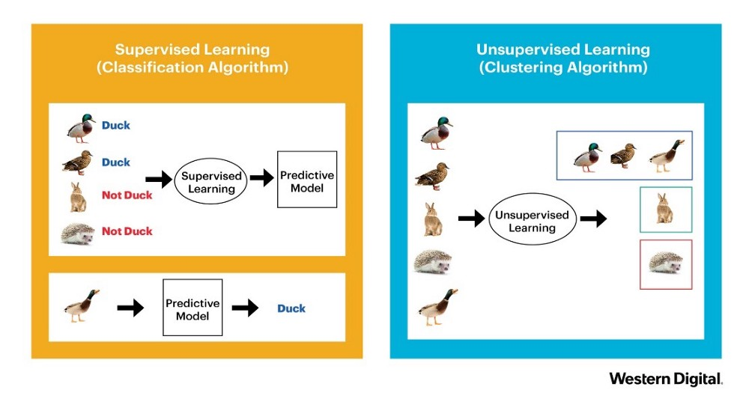
Supervised learning
Labelled data → predictive model

Slide 68
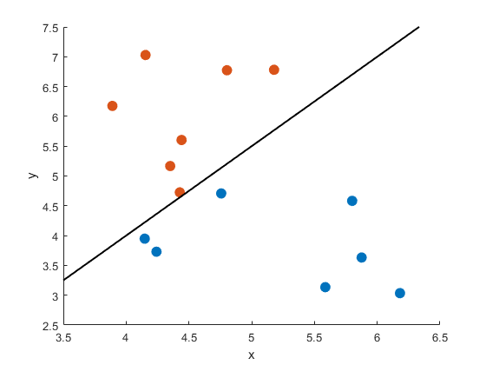


Supervised learning – Classification
= 1 (is red)
= 0 (is not red)
Split data in two with a line / hyperplane
Very probable = red
$y=$1
Uncertain
Very probable = blue
$y=$0

Slide 69
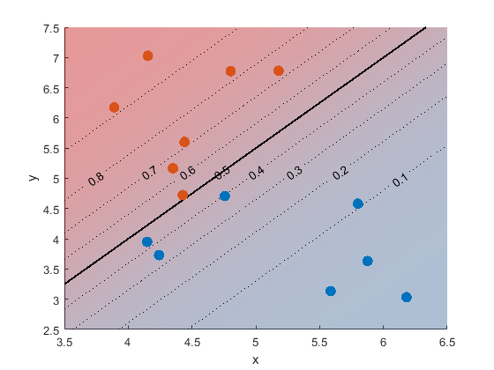



Supervised learning – Classification
= 1 (is red)
= 0 (is not red)
Split data in two with a line / hyperplane
Sigmoid function
Very probable = red
$y=$1
$$y_{pred}=0.95$$
$$σ=\frac{1}{1+e^{−x}}$$
Very probable = blue
$y=$0
$$y_{pred}=0.05$$

Slide 70
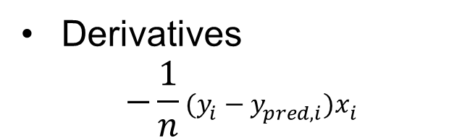

Supervised learning – Classification
= 1 (is red)
= 0 (is not red)
Split data in two with a line / hyperplane
Sigmoid function
Very probable = red
Minimize Log-loss
$y=$1
$$y_{pred}=0.95$$
$$−\frac{1}{n}\sum_{i=1}^{n}{\left(y_{i}\log{{(y}_{pred,i})}−{(1−y}_{i})\log{{(1−y}_{pred,i})}\right)}$$
$$σ=\frac{1}{1+e^{−x}}$$
Derivatives
$$−\frac{1}{n}{(y_{i}−y}_{pred,i})x_{i}$$
Very probable = blue
$y=$0
$$y_{pred}=0.05$$

Slide 71
Supervised learning – Classification
= 1 (is red)
= 0 (is not red)
Logistic regression
Split data in two with a line / hyperplane
Very probable = red
$y=$1
$$y_{pred}=0.95$$
Very probable = blue
$y=$0
$$y_{pred}=0.05$$

Slide 72
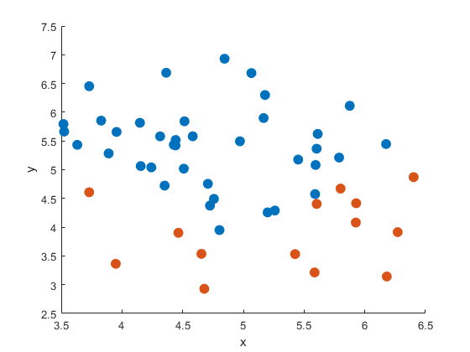
Supervised learning – Classification

Slide 73
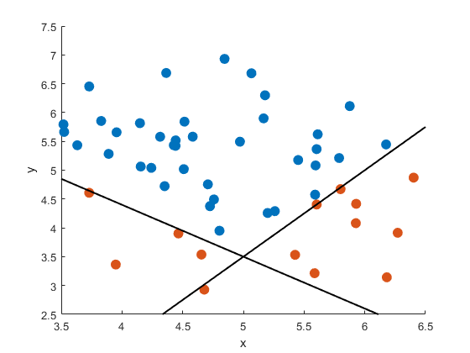
Supervised learning – Classification

Slide 74
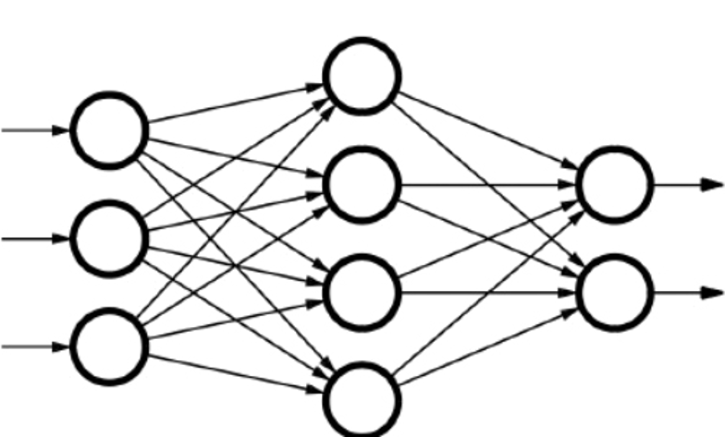
Neural networks
Neuron
Input layer
Output layer
Hidden layer

Slide 75
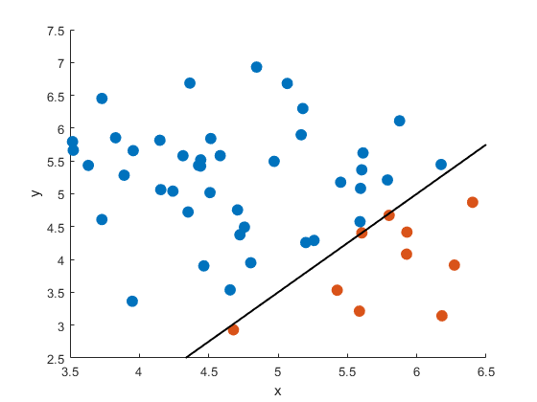
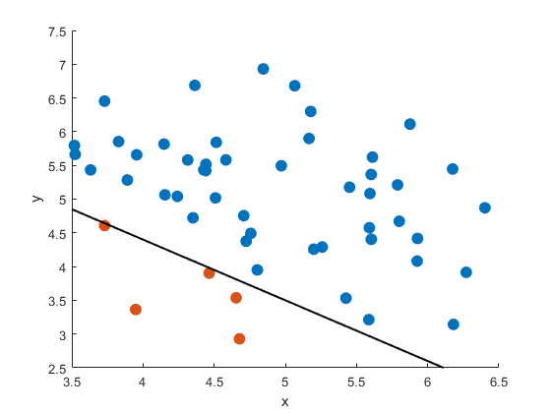
Neural networks
Feature 1
Feature 2
Input layer
Hidden layer
Output layer

Slide 76
Machine learning
Machine learning
Supervised learning
Classification:
Predict a category
Regression:
Predict a number
Unsupervised learning
Clustering:
Divide by similarity
Reinforcement learning
Association:
Identify sequences
Dimension reduction:
Find hidden dependencies
Decision making:
Automatic decision making

Slide 77



Reinforcement learning
No “right or wrong” input sequence – just act “smart” in the environment
Environment
Interpreter
Action
Reward
Agent
State

Slide 78


Reinforcement learning
Reward
Environment
Action
Agent

Slide 79
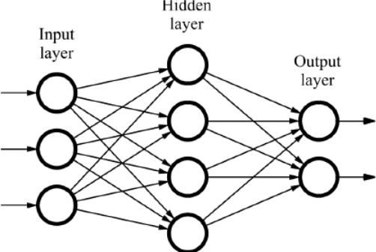
Reinforcement learning
Policy network

Slide 80
Reinforcement learning
Monte Carlo simulations to create lots of data
Policy network
Policy gradient to train network

Slide 81
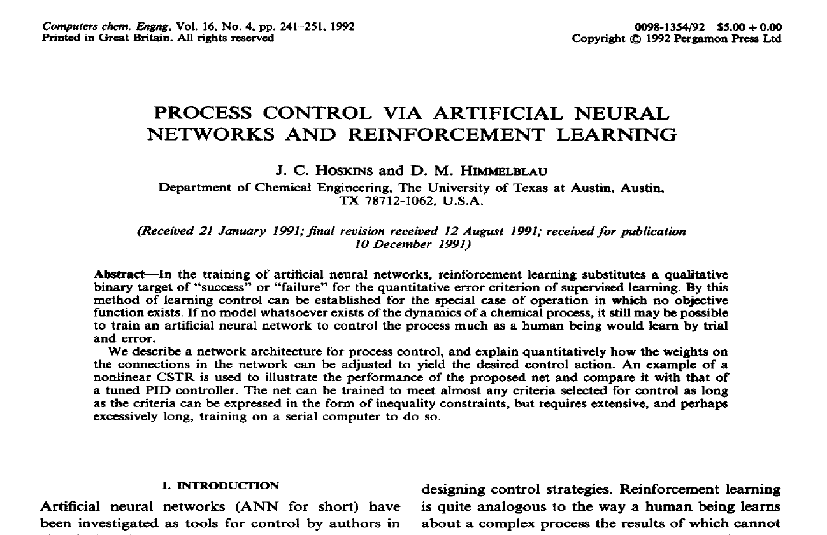

Slide 82
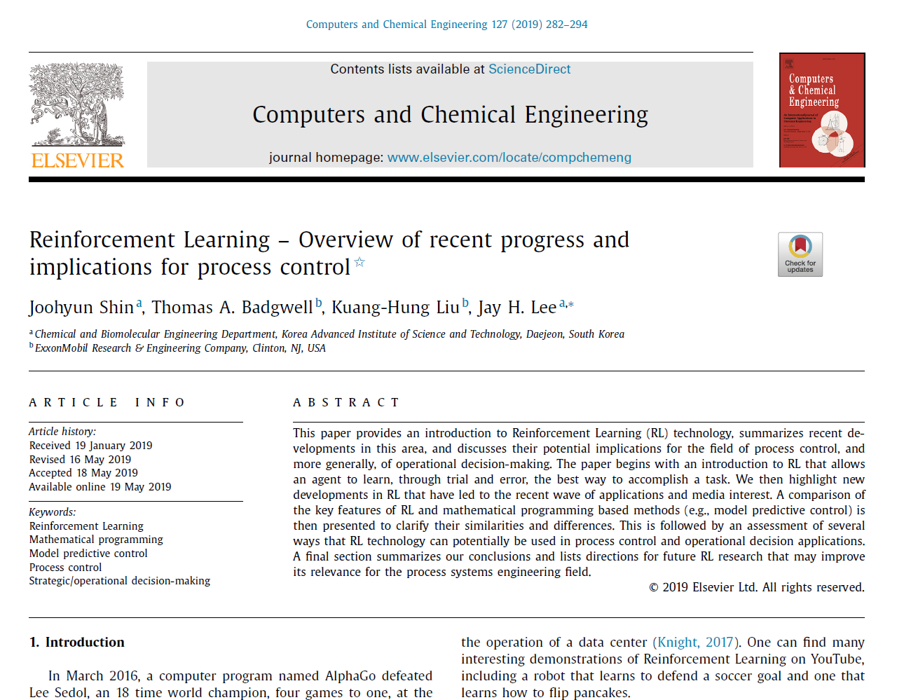
“
“In summary, we believe that RL technology has the potential to significantly impact both theory and applications in the field of process control and more general fields involving multi-timescale decision-making. “

Slide 83
Conclusion
Machine learning is used to teach a computer to do a task without being explicitly programmed
Many areas of application
Not magic, but based on simple mathematical principles

Slide 84
Sources
Serrano, Luis. Lecture series “Machine Learning & Math Made Easy”. “https://www.youtube.com/channel/UCgBncpylJ1kiVaPyP-PZauQ,” 2017.
Karpathy, Andrej et al. “Generative models”. “https://openai.com/blog/generative-models/,” 16-06-2016
Osinski, Blazej, and Konrad Budek. “What is reinforcement learning? The complete guide”. “https://deepsense.ai/what-is-reinforcement-learning-the-complete-guide/,” 05-07-2018.
Mordvintsev, Alexander, Christopher Olah and Mike Tyka. “Inceptionism: Going Deeper into Neural Networks.” Google Research Blog: “https://ai.googleblog.com/2015/06/inceptionism-going-deeper-into-neural.html,” 17-06-2015.
Szegedy, Christian, et al. "Going deeper with convolutions." Proceedings of the IEEE conference on computer vision and pattern recognition. 2015.
Ernst, Damien, et al. "Reinforcement learning versus model predictive control: a comparison on a power system problem.“ IEEE Transactions on Systems, Man, and Cybernetics, Part B (Cybernetics)39.2 (2009): 517-529.
Badgwell, Thomas A., Jay H. Lee, and Kuang-Hung Liu. "Reinforcement learning–overview of recent progress and implications for process control." Computer Aided Chemical Engineering. Vol. 44. Elsevier, 2018. 71-85.
Spielberg, S. P. K., R. B. Gopaluni, and P. D. Loewen. "Deep reinforcement learning approaches for process control." 2017 6th international symposium on advanced control of industrial processes (AdCONIP). IEEE, 2017.
Hoskins, J. C., and D. M. Himmelblau. "Process control via artificial neural networks and reinforcement learning." Computers & chemical engineering 16.4 (1992): 241-251.
Heinz, Sebastian. “Using Reinforcement Learning to play Super Mario Bros on NES using TensorFlow”. “https://towardsdatascience.com/using-reinforcement-learning-to-play-super-mario-bros-on-nes-using-tensorflow-31281e35825,” 29-05-2019.
Hadjeres, Gaëtan, François Pachet, and Frank Nielsen. "Deepbach: a steerable model for bach chorales generation." Proceedings of the 34th International Conference on Machine Learning-Volume 70. JMLR. org, 2017.

Slide 85
Machine learning, basic principles and example applications
Trial lecture
Adriaen Verheyleweghen
Supervisor: Johannes Jäschke
Co-supervisor: Sigurd Skogestad
June 12, 2020

